Slide 1
Invariant Feature Learning for Generalized Long-Tailed Classification
Kaihua Tang, Mingyuan Tao, Jiaxin Qi, Zhenguang Liu,
Hanwang Zhang
Nanyang Technological University, Damo Academy, Zhejiang University
Notes:
Hello everyone, this presentation is about our recent work on ECCV: invariant feature learning for generalized long-tailed classification

Slide 2
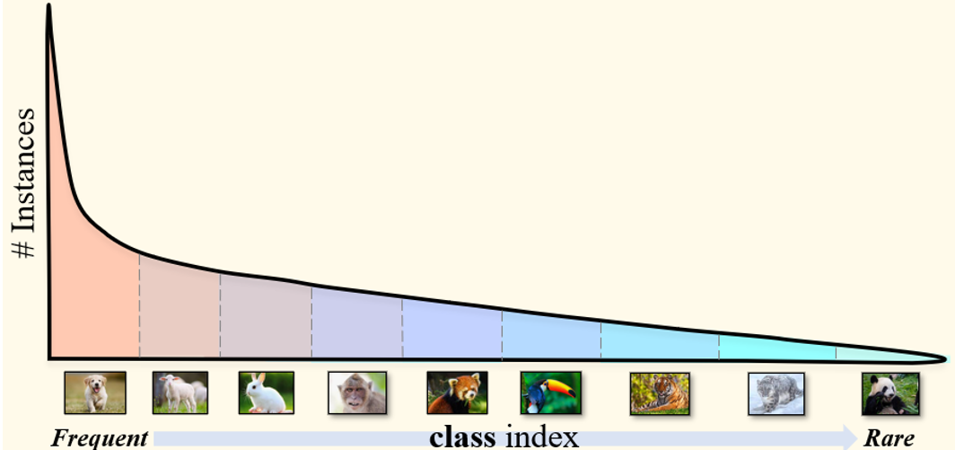
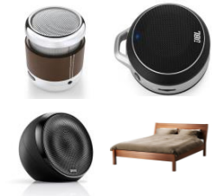
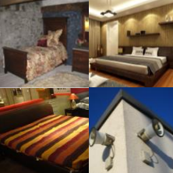
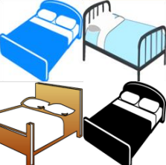
Beyond Class-wise Imbalance
Long-tailed Image Classification
Domain Generalization
Unified
Formulation
Domain 1
Domain 2
Unbiased Scene Graph Generation
Sub-population Shift
Class-wise Data Imbalance
Attribute-wise Data Imbalance
Notes:
Previously, the long-tailed classification is only care about class-wise data imbalance
However, the attribute-wise data imbalance can also suffer from the long-tailed problem
But they are usually studied as different tasks like DG and sub-population shift.
We believe that a unified formulation of both biases is important

Slide 3
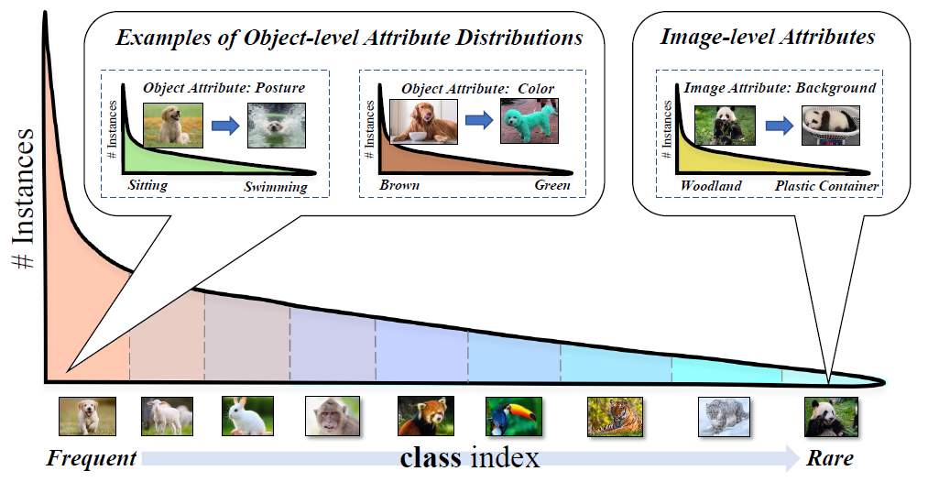
Beyond Class-wise Imbalance
Generalized Long-Tailed Classification
Notes:
Therefore, we propose a new task, called generalized long-tailed classification, which is composed of class-wise imbalance and attribute-wise imbalance.

Slide 4
Problem Formulation of Existing LT Methods
Previous LT Formulation[1]:
$$P\left(y | x\right)=\frac{P\left(x | y\right)}{P\left(x\right)}P\left(y\right)$$
$$∝P\left(x | y\right)P(y)$$
Assumption:
$$P_{tr}\left(x | y\right)=P_{te}\left(x | y\right)$$
Unbiased Prediction:
$log\left(P\left(y | x\right)\right)−log(P(y))$
$$=log\left(\frac{P(x,y)}{P\left(x\right)⋅P(y)}\right)$$
Point-wise mutual information
[1] Menon, Aditya Krishna, et al. "Long-tail learning via logit adjustment." ICLR 2021
Notes:
Before we dive into the formulation of our GLT task, let’s look at the problem of existing LT formulation.
The current methods consider P(y) of training data as the only cause of bias, assuming the intra-class distributions are fixed.

Slide 5
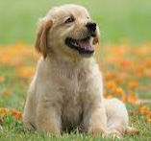
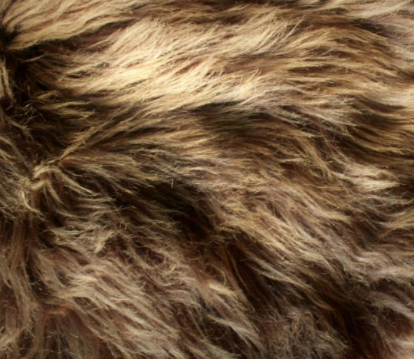
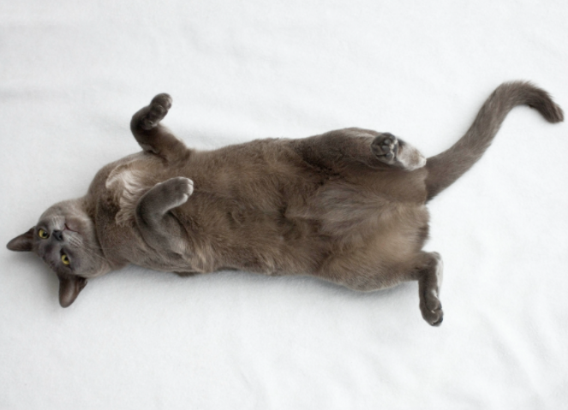
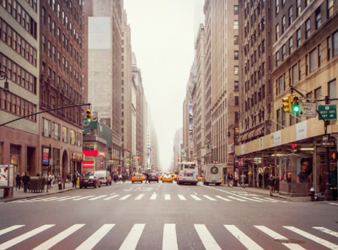
The Limitation of Logit Adjustment
Previous Assumption:
$$P_{tr}\left(x | y\right)=P_{te}(x|y)$$
An Image $x$
$$/$$
Too Strong !
Our extension:
$$P\left(x | y\right)=P\left(z_{c},z_{a} | y\right)$$
$$=P\left(z_{c} | y\right)P(z_{a}|z_{c},y)$$
New Assumption:
$$P_{tr}\left(z_{c} | y\right)=P_{te}\left(z_{c} | y\right), ∃z_{c} in all x∈y$$
Consistent
Contents $z_{c}$
Class Prototype
dog:
cat:
Object-level Attributes
IID Classification:
$$P_{tr}\left(z_{a} | z_{c},y\right)=P_{te}(z_{a}|z_{c},y)$$
OOD Classification:
$$P_{tr}\left(z_{a} | z_{c},y\right)≠P_{te}(z_{a}|z_{c},y)$$
Inconsistent Attributes $z_{a}$
texture:
posture:
Image-level Attributes
background:
[1] Menon, Aditya Krishna, et al. "Long-tail learning via logit adjustment." ICLR 2021
Notes:
However, this assumption is too strong for real datasets.
Given an image x, it not just contains consistent components like class prototype, but also inconsistent attributes like textures and backgrounds.
Therefore, we provide a more practical assumption that only part of the features are consistent.

Slide 6
Problem Formulation (General)
An Image $x$
$$/$$
Problem Formulation:
$$p\left(Y=k | X=x\right)=p(Y=k|z_{c},z_{a})$$
Consistent Contents $z_{c}$
Class Prototype
dog:
cat:
$$=\frac{p(z_{c},z_{a}|Y=k)}{p(z_{c},z_{a})}⋅p(Y=k)$$
$$=\frac{p(z_{c}|Y=k)}{p(z_{c})}⋅\frac{p(z_{a}|Y=k,z_{c})}{p(z_{a}|z_{c})}⋅p(Y=k)$$
Object-level Attributes
Inconsistent Attributes $z_{a}$
texture:
posture:
attribute bias
class bias
Image-level Attributes
background:
Notes:
So, we come up with our final formulation of learning from imbalanced data.
It has two kinds of bias terms

Slide 7
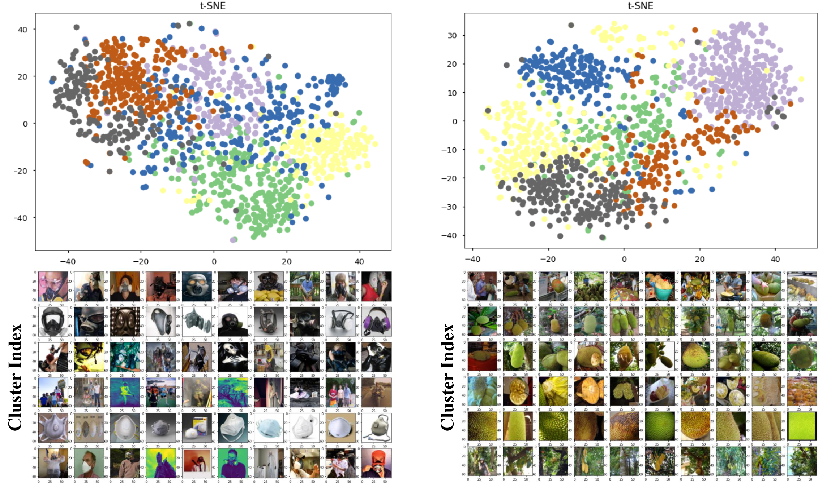
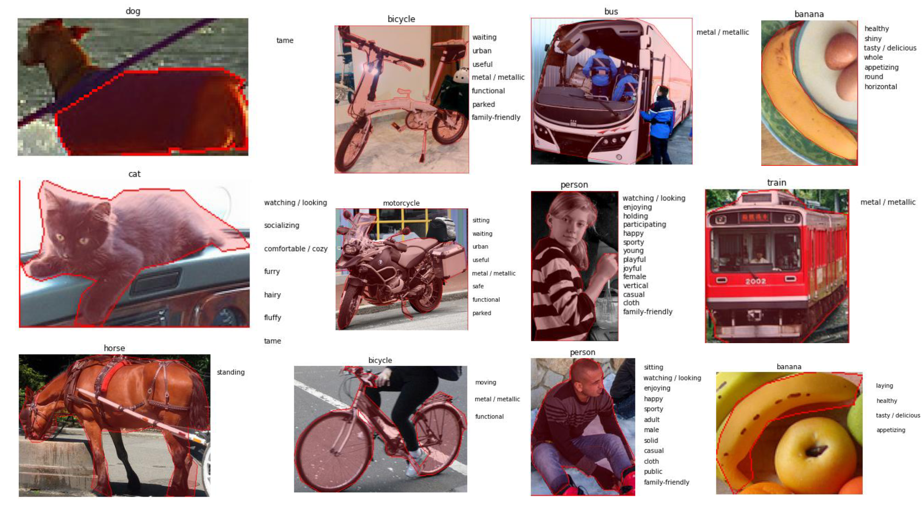
Benchmarks, Protocols and Metrics
ImageNet-GLT using Pseudo Attributes
MSCOCO-GLT using Annotated Attributes
Evaluation Protocols:
Class-wise Long Tail (CLT) Protocol
Attribute-wise Long Tail (ALT) Protocol
Generalized Long Tail (GLT) Protocol
Evaluation Metrics:
Top-1 Accuracy
Top-1 Precision
Acc-Prec trade-off is not real robustness!
Notes:
We also construct two benchmarks:
ImageNet-GLT using Pseudo Attributes
and MSCOCO-GLT using manually annotated Attributes
Together with Three Evaluation Protocol and Two Metrics (accuracy and precision)

Slide 8
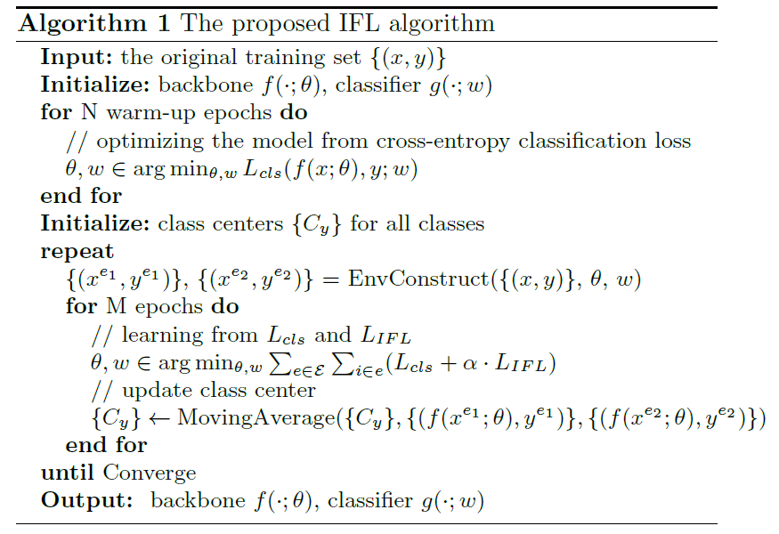
IFL: Invariant Version of Center Loss
Invariant Feature Learning (IFL):
$$\min_{θ,w}{\sum_{e∈E}{\sum_{i∈e}{L_{cls}(f\left(x_{i}^{e};θ\right),y_{i}^{e};w)}},}$$
$$subject to θ∈argmin_{θ}\sum_{e∈E}{\sum_{i∈e}{{\left\|f\left(x_{i}^{e};θ\right)−C_{y_{i}^{e}}\right\|}_{2}}}$$
Invariant Risk Minimization^{[1]} version of Center Loss^{[2]}
Original
IRM
[1] Arjovsky, M., Bottou, L., Gulrajani, I., & Lopez-Paz, D. Invariant risk minimization. arXiv preprint arXiv. 2019
[2] Wen, Y., Zhang, K., Li, Z., & Qiao, Y. A discriminative feature learning approach for deep face recognition. ECCV, 2016.
Notes:
To solve the additional attribute-wise imbalance, we propose a new Invariant Feature Learning framework.
Intuitively, the proposed IFL extends the popular center loss to is IRM version.
It will encourage features to be consistent across the environments with different intra-class distributions.
Note that we don’t use the original IRM constrain, as it’s very unstable in the real-world dataset

Slide 9
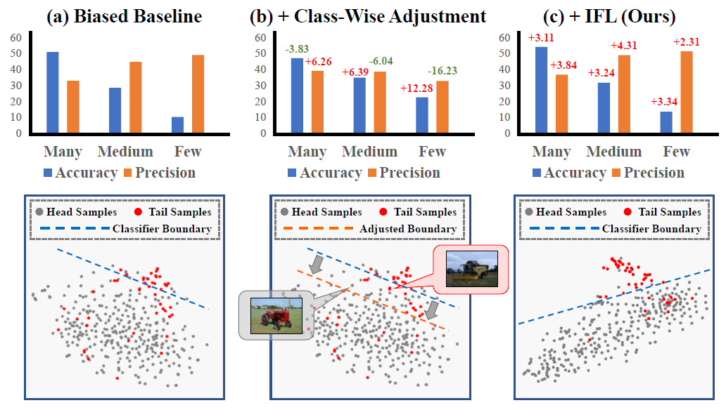
Difference Between IFL and Class Adjustment
Notes:
To better understand the advantage of IFL
We visualize some feature points in this figure.
For biased CE baselines, both the feature space contains the confusing regions and the classifier boundary is biased.
For conventional LT method, they mainly change decision boundaries of the classifier
However, the confusing regions in feature space caused by the biased attribute, cannot be solved by simply adjusting the classfier,
Since the proposed IFL focuses on improving the quality of Features, it learns more robust feature space that the confusing region between class boundaries is also minimized.

Slide 10
Why GLT is a “generalized” version of LT
Notes:
The reason why the proposed task is the “generalized” version of LT is that
Our baselines will automatically improve the class-wise LT problem as well, but not in the other direction.

Slide 11
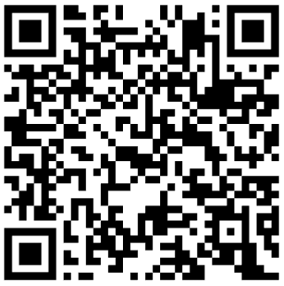
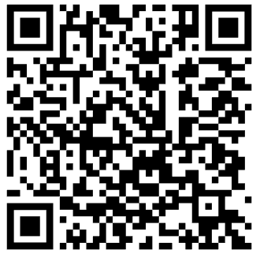
Thank You
Full Presentation
30 min:
Code Link:
Paper Link:

