Slide 1
Invariant Feature Learning for Generalized Long-Tailed Classification
Kaihua Tang
Nanyang Technological University

Slide 2
Outline
Background and Motivation
The Generalized Long-tailed Formulation
The Proposed Benchmarks
The Proposed Baseline Methods
Experimental Results

Slide 3
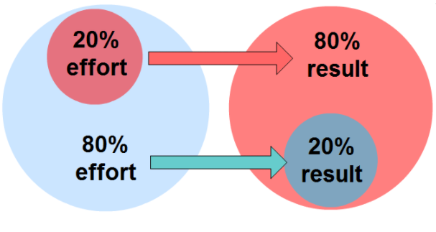
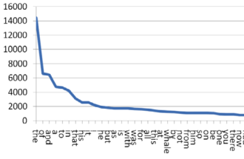
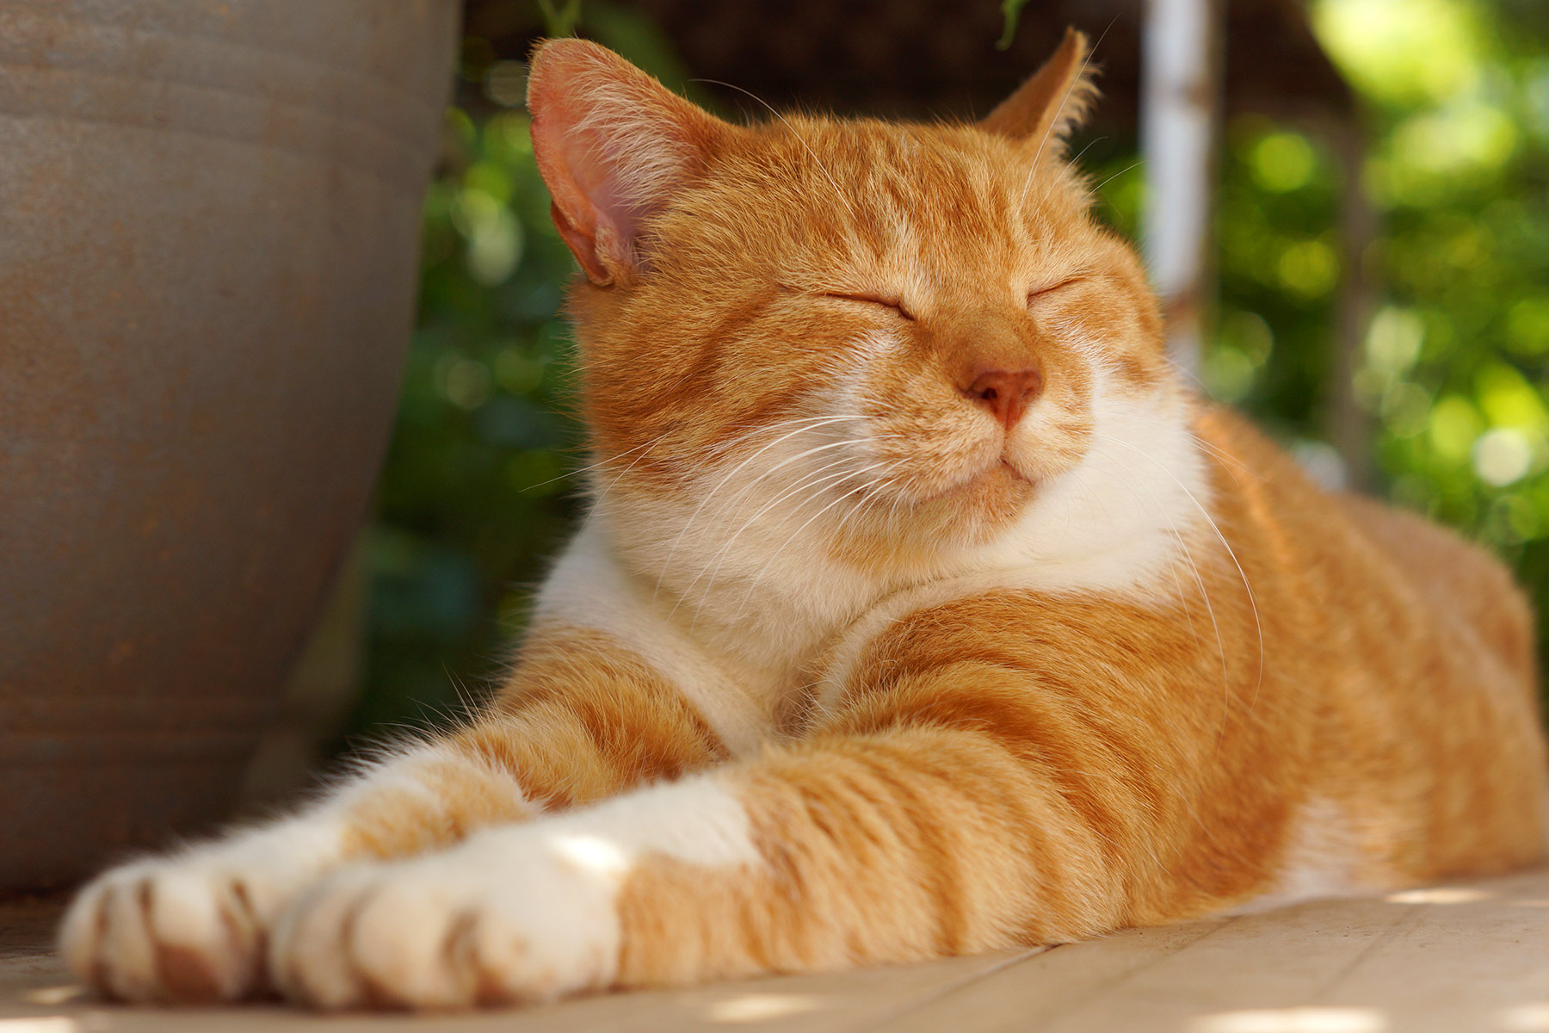
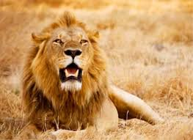
The Ubiquitous Long-tailed Distribution
What is long-tailed distribution?
NLP $→$ Zipf’s Law
Economics $→$ Pareto Principle
Computer Vision
Number of Instances
Head Classes
(Most of the data)
Tail Classes (Most of the categories)
Categories Ranking by Frequency
Notes:
What is long-tailed distribution?
It ubiquitously exists in all kinds of tasks
Creating a significant data imbalance

Slide 4
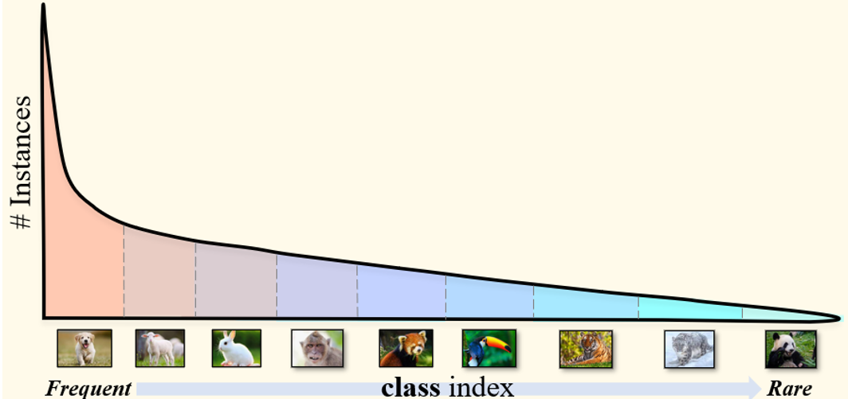
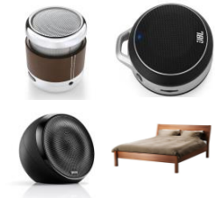
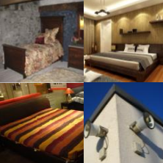
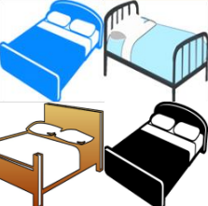
Beyond Class-wise Imbalance
Long-tailed Image Classification
Domain Generalization
Unified
Formulation
Domain 1
Domain 2
Unbiased Scene Graph Generation
Sub-population Shift
Class-wise Data Imbalance
Attribute-wise Data Imbalance
Notes:
However, in the previous LT classification, or Unbiased SGG,
Most of the researchers only consider the class-wise data imbalance on the predicted categories.
However, the attribute within each class can also be long-tailed.
In computer vision, the attribute-wise data imbalance are usually studied as DG or Sub-population shift.
Previously, these two kinds of long-tailed data imbalance problems are studied as two independent fields.
But, the question is, is there a unified formulation for both problems?

Slide 5
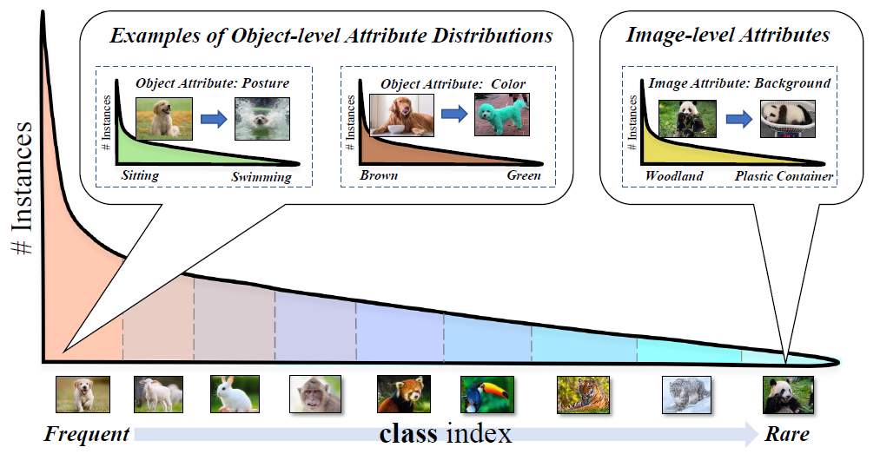
Beyond Class-wise Imbalance
Data Imbalance = Class-wise Imbalance + Attribute-wise Imbalance
Notes:
Therefore, in this work, we consider the general data imbalance is composed of two different kinds of imbalances : XXXX + XXXX
They co-exist with each other in a real-world dataset

Slide 6
Outline
Background and Motivation
The Generalized Long-tailed Formulation
The Proposed Benchmarks
The Proposed Baseline Methods
Experimental Results
Notes:
To begin with, Let’s start with the formulation of LT and see what’s the problem of existing LT methods.

Slide 7
Problem Formulation of LT
Logit Adjustment [1]:
$$P\left(y | x\right)=\frac{P\left(x | y\right)}{P\left(x\right)}P\left(y\right)$$
$$∝P\left(x | y\right)P(y)$$
Assumption:
$$P_{tr}\left(x | y\right)=P_{te}\left(x | y\right)$$
Unbiased Prediction:
$log\left(P\left(y | x\right)\right)−log(P(y))$
$$=log\left(\frac{P(x,y)}{P\left(x\right)⋅P(y)}\right)$$
Point-wise mutual information
[1] Menon, Aditya Krishna, et al. "Long-tail learning via logit adjustment." ICLR 2021
Notes:
I will use my favorite formulation from Google as an example
This formulation is used in their paper Logit adjustment.
In LA, it apply bayes theorem for P(y|x), and identify P(y) as the cause of LT bias.
Their assumption is that XXXX
Therefore, the solution is quite simple, XXXX. It can also be considered as optimize the pointwise mutual information during training.

Slide 8
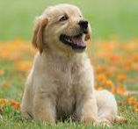
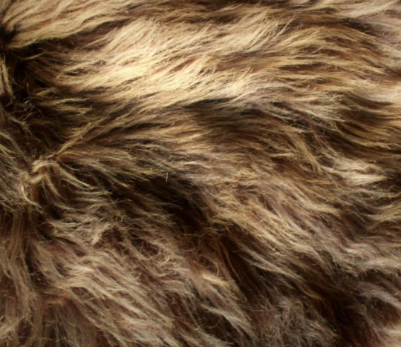
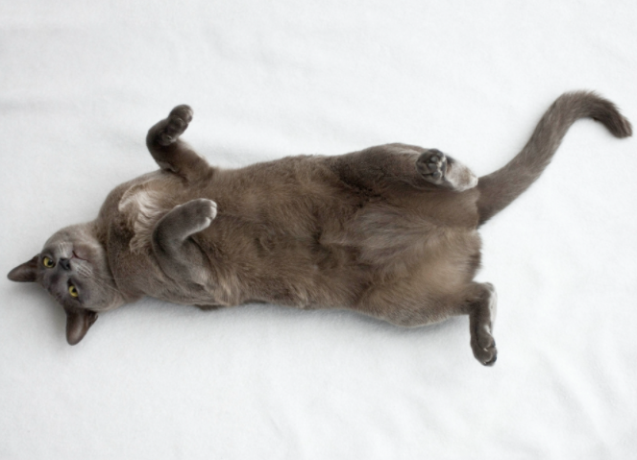
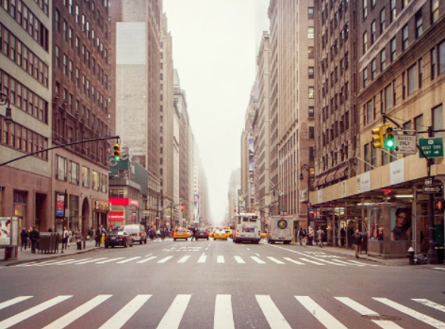
The Limitation of Logit Adjustment
Previous Assumption:
$$P_{tr}\left(x | y\right)=P_{te}(x|y)$$
An Image $x$
$$/$$
Too Strong !
Our extension:
$$P\left(x | y\right)=P\left(z_{c},z_{a} | y\right)$$
$$=P\left(z_{c} | y\right)P(z_{a}|z_{c},y)$$
New Assumption:
$$P_{tr}\left(z_{c} | y\right)=P_{te}\left(z_{c} | y\right), ∃z_{c} in all x∈y$$
Consistent
Contents $z_{c}$
Class Prototype
dog:
cat:
Object-level Attributes
IID Classification:
$$P_{tr}\left(z_{a} | z_{c},y\right)=P_{te}(z_{a}|z_{c},y)$$
OOD Classification:
$$P_{tr}\left(z_{a} | z_{c},y\right)≠P_{te}(z_{a}|z_{c},y)$$
Inconsistent Attributes $z_{a}$
texture:
posture:
Image-level Attributes
background:
[1] Menon, Aditya Krishna, et al. "Long-tail learning via logit adjustment." ICLR 2021
Notes:
However, this assumption is too strong for real datasets.
Given an image x, it not just contains XXXX, but also XXXX
So our new assumption is that only z_c is consistent across the training and testing domains.
Note that the z_c must exist for each class, otherwise, it’s impossible to learn a robust classifier in the first place.
Based on our new assumption, XXX

Slide 9
Problem Formulation (General)
The underlying causal graph
Problem Formulation:
An Image $x$
$$/$$
$$Y$$
$$ε$$
$$p\left(Y=k | X=x\right)=p(Y=k|z_{c},z_{a})$$
Consistent Contents $z_{c}$
Class Prototype
dog:
cat:
$$=\frac{p(z_{c},z_{a}|Y=k)}{p(z_{c},z_{a})}⋅p(Y=k)$$
$${ Z}_{c}$$
$${ Z}_{a}$$
$$=\frac{p(z_{c}|Y=k)}{p(z_{c})}⋅\frac{p(z_{a}|Y=k,z_{c})}{p(z_{a}|z_{c})}⋅p(Y=k)$$
Object-level Attributes
Inconsistent Attributes $z_{a}$
texture:
posture:
attribute bias
class bias
$$X$$
Image-level Attributes
background:
Notes:
So, we can come up with our final formulation of learning from imbalanced data.
It has two kinds of biases: XXX
This formulate is based on this underlying causal graph.
For each Y, class template Z_c, template has a set of Z_a, XXXX

Slide 10
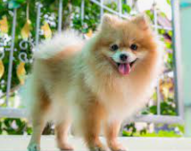
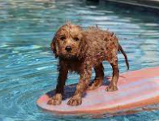
Attribute Bias I
Inconsistent performance/confidence within each class
$$\frac{p(z_{a}=wet|Y=dog,z_{c}=fur)}{p(z_{a}=wet|z_{c}=fur)}<\frac{p(z_{a}=fluffy|Y=dog,z_{c}=fur)}{p(z_{a}=fluffy|z_{c}=fur)}$$
$$p\left(Y=dog | z_{c}=fur,z_{a}=wet\right)<p\left(Y=dog | z_{c}=fur,z_{a}=fluffy\right)$$
Attributes of “fur” under Y=“dog”
Prediction Confidence under Y=“dog”
# Instances
Accuracy
fluffy
wet
fluffy
wet
Notes:
The consequence of class-wise bias is very intuitive, it’s just the unfair advantages of head categories.
But the attribute-wise bias within each class is much more tricky, because theoretically, it should not related to the classification results.
Let’s see the problems caused by the attribute bias.
1) XXXX

Slide 11
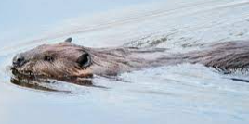
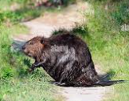
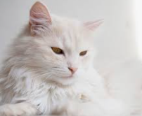
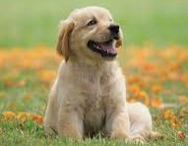
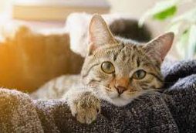
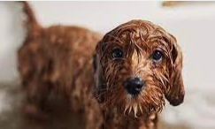
Attribute Bias II
Spurious Correlation (Why samples are mis-classified into other categories?)
$$\frac{p(z_{a}=wet|Y=beave,z_{c}=fur)}{p(z_{a}=wet|z_{c}=fur)}≫1$$
$$p(Y=beaver|z_{c}=fur,z_{a}=wet)$$
Attributes of “fur” under Y=“beaver”
Overall Attribute Distribution of “fur”
A dog with wet fur
……
# Instances
# Instances
wrong prediction:
beaver
wet
wet
others
others
dry
fluffy
Notes:
2) XXXXX

Slide 12
Outline
Background and Motivation
The Generalized Long-tailed Formulation
The Proposed Benchmarks
The Proposed Baseline Methods
Experimental Results
Notes:
Since the previous benchmarks can either study the class-wise long-tailed problem or attribute-wise long-tailed problem,
There are no existing benchmarks we can use.
Therefore, we need to proposed our own benchmarks to study the above mentioned two biases together.

Slide 13
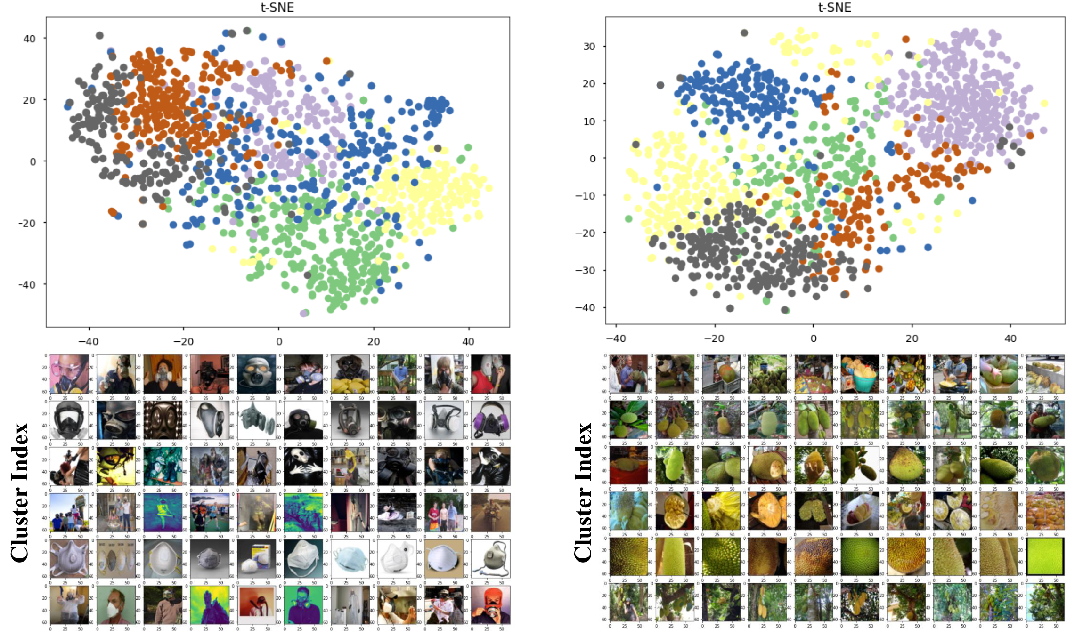
ImageNet-GLT
Notes:
The first benchmark is called ImageNet-GLT
It doesn’t have attribute annotations, so XXXXX

Slide 14
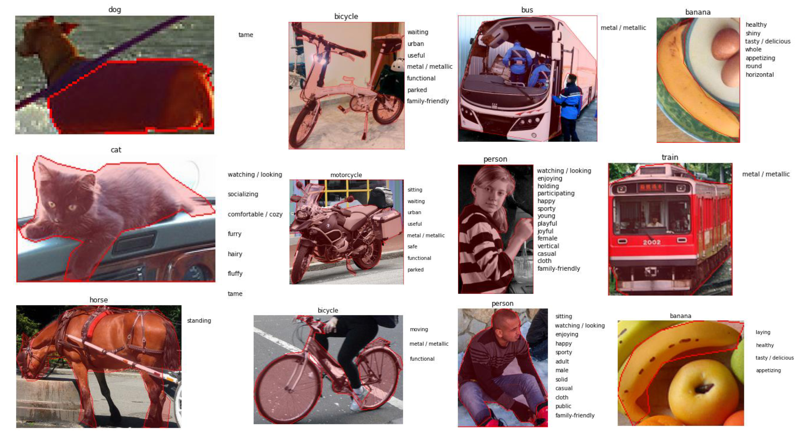
MSCOCO-GLT from MSCOCO-Attribute
Notes:
The second benchmark is MSCOCO-GLT.
It’s constructed from MSCOCO-attribute dataset.
It has real attribute annotations.
Note that the attribute is multi-label, and each object can have multiple attributes at the same time.
It makes attribute-wise imbalance much harder, as XXXXXX

Slide 15
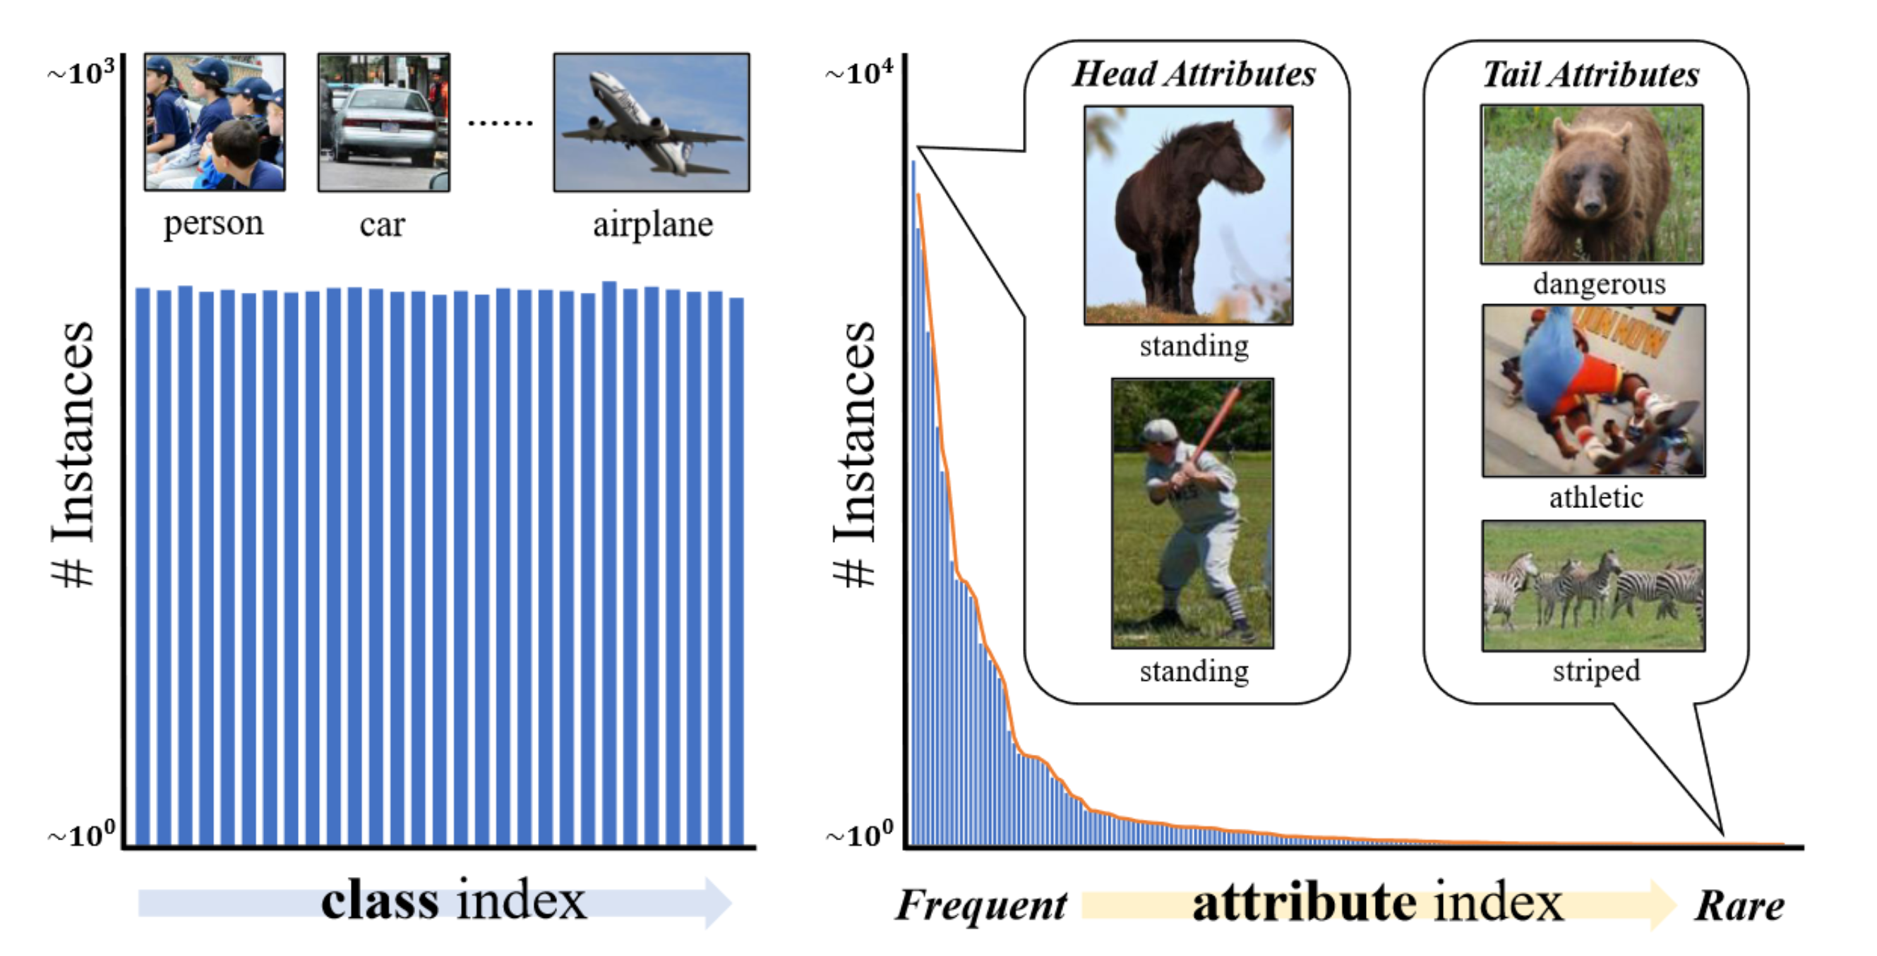
MSCOCO-GLT from MSCOCO-Attribute
Notes:
Here is an example of a class-wise balanced MSCOCO-GLT training set.
The attribute-wise distribution is still long-tailed, which explains the previous LT algorithm cannot solve the GLT

Slide 16
Evaluation Protocols and Metrics
Evaluation Protocols:
Class-wise Long Tail (CLT) Protocol: Train-GLT + Test-CBL
Attribute-wise Long Tail (ALT) Protocol: Train-CBL + Test-GBL
Generalized Long Tail (GLT) Protocol: Train-GLT + Test-GBL
Evaluation Metrics:
Top-1 Accuracy (equals to top-1 recall in class-wise balanced test sets)
Top-1 Precision (precision-recall trade-off is not real robustness against distribution shifts!)
Notes:
To better evaluate the robustness against the data imbalance,
I adopted three protocols: XXX XX XX
I further use both top-1 accuracy together with top-1 precision to be our evaluation metrics.
The conventional LT classification only report accuracy, but it can be easily cheated by precision-recall trade-off.
So we reported precision as well

Slide 17
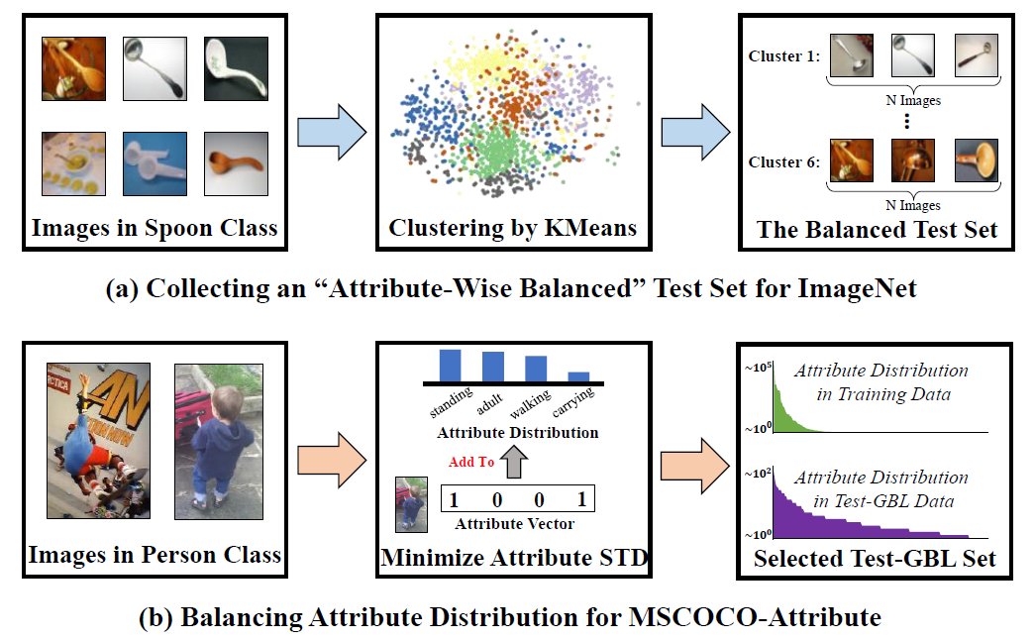
Constructing Test-GBL
We can never strictly balance the attribute distribution, as attributes always co-occur with each other.
Notes:
In all training or testing splits from the above three protocols,
Constructing generalized balanced testing set Test-GBL is the most challenging problem.
For ImageNet-GLT, XXXX
For MSCOCO-GLT, XXXX

Slide 18
Some Statistics: ImageNet-GLT
Notes:
These are the class and attribute statistics for all training and testing splits in ImageNet-GLT

Slide 19
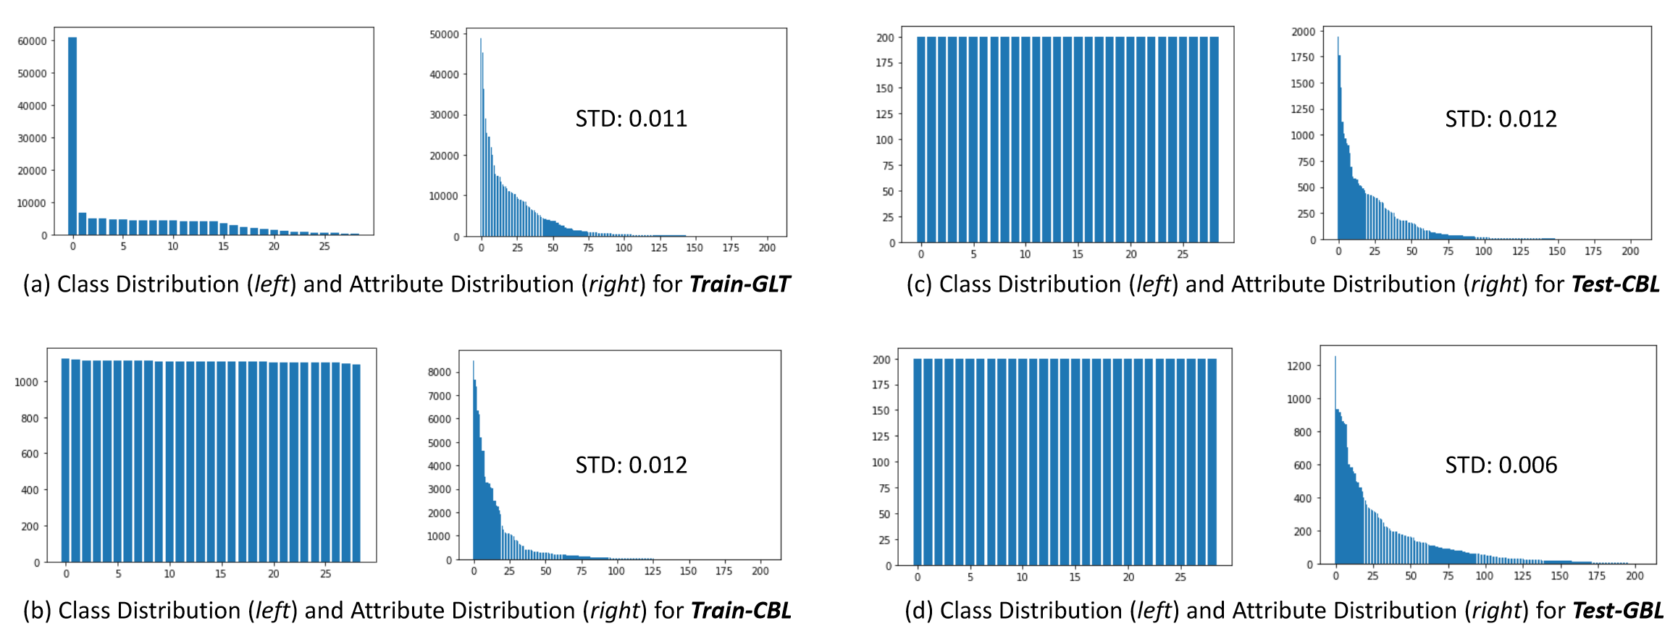
Some Statistics: MSCOCO-GLT
Notes:
These are statistics for MSCOCO-GLT.
Note that the attribute distribution of Test-GBL is not strictly balanced, but its STD is lower than the biased training set,
Making it relatively more balancing.

Slide 20
Outline
Background and Motivation
The Generalized Long-tailed Formulation
The Proposed Benchmarks
The Proposed Baseline Methods
Experimental Results
Notes:
Next, let’s look at our proposed baseline method

Slide 21
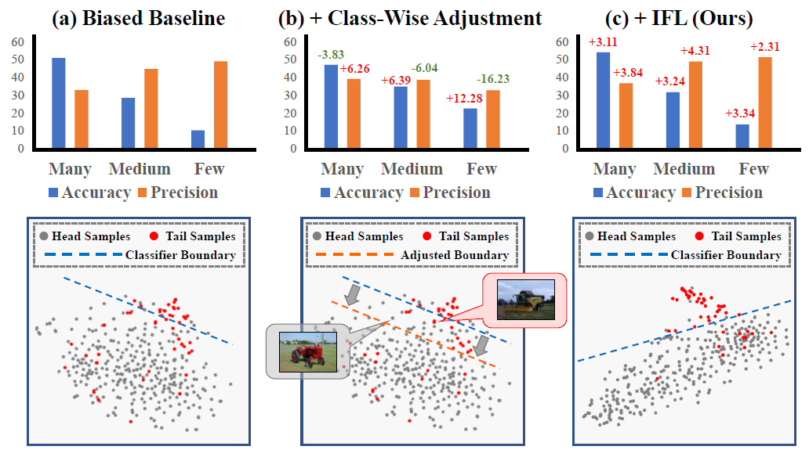
The Limitation of Class-wise LT
Notes:
To better understand two kinds of biases,
We visualize some feature points in this figure.
For biased CE baselines, both the feature space contains the confusing regions and the classifier boundary is biased.
For conventional LT method -> classifier -> change decision boundaries
The attribute bias cause the confusing regions between boundaries, cannot be solved by moving boundaries.
So we need better Feature learning, the proposed IFL aims to learn more robust feature space so the confusing region between class boundaries can be reduced.

Slide 22
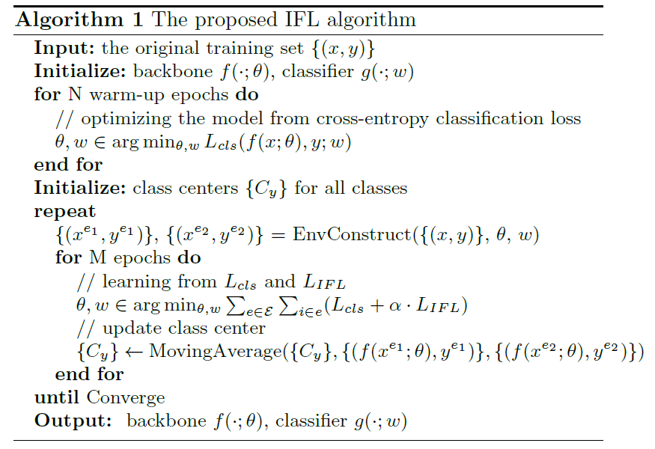
IFL: Invariant Version of Center Loss
Invariant Feature Learning:
$$\min_{θ,w}{\sum_{e∈E}{\sum_{i∈e}{L_{cls}(f\left(x_{i}^{e};θ\right),y_{i}^{e};w)}},}$$
$$subject to θ∈argmin_{θ}\sum_{e∈E}{\sum_{i∈e}{{\left\|f\left(x_{i}^{e};θ\right)−C_{y_{i}^{e}}\right\|}_{2}}}$$
Invariant Risk Minimization^{[1]} version of Center Loss^{[2]}
Original
IRM
[1] Arjovsky, M., Bottou, L., Gulrajani, I., & Lopez-Paz, D. Invariant risk minimization. arXiv preprint arXiv. 2019
[2] Wen, Y., Zhang, K., Li, Z., & Qiao, Y. A discriminative feature learning approach for deep face recognition. ECCV, 2016.
Notes:
Intuitively, the proposed IFL extends the popular center loss to is IRM version.
Here I won’t go too far into the IRM, as we didn’t following the original implementation.
Intuitively, we can consider IRM as a penalty that XXX
The proposed IFL will encourage the features to be consistent across the environments with different attribute distributions.
Note that we don’t use the original IRM constrain, as it’s very unstable in the real-world dataset

Slide 23
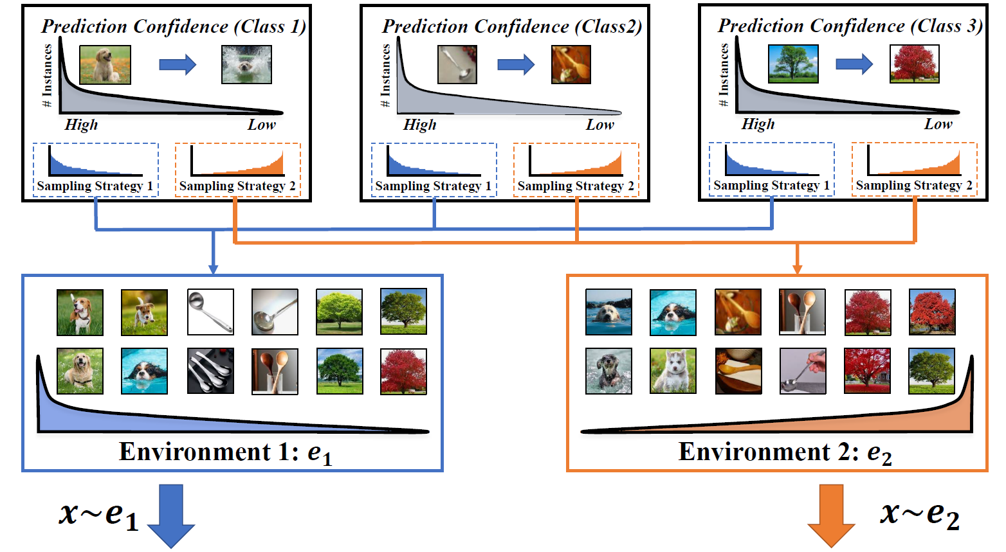
The Proposed Baseline Method (I)
Stage 1: Constructing Diverse Environments (similar to bias discovery)
Notes:
Here is how we construct environments.
As we introduced before, the performance within each class is high correlated to the frequency of attributes.
The more frequent XXX, Conduct different sampling strategies within each class, XXX
The final environments will have different attribute distributions
(this kind of strategy is also used in some recent bias discovery papers)

Slide 24
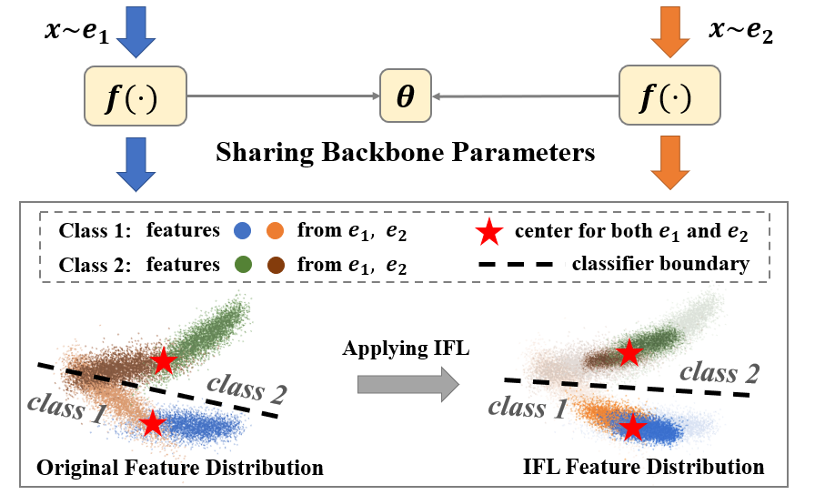
The Proposed Baseline Method (II)
Stage 2: Learning Representations Invariant to the Environments
Notes:
Then the next step is to learn a feature presentation that is invariant to the attribute change.
This step will force the model to learn features that have consistent distributions across the environments.
This method can reduce the confusing regions between class boundaries that caused by shared attributes

Slide 25
Outline
Background and Motivation
The Generalized Long-tailed Formulation
The Proposed Benchmarks
The Proposed Baseline Methods
Experimental Results
Notes:
next, I will show some experimental results

Slide 26
Experiments on ImageNet-GLT
Notes:
Not surprisingly, the proposed IFL can boost the generalized long-tailed classification in all settings.
It can also be plugged into the previous class-wise long-tailed algorithm to further improve their performances.

Slide 27
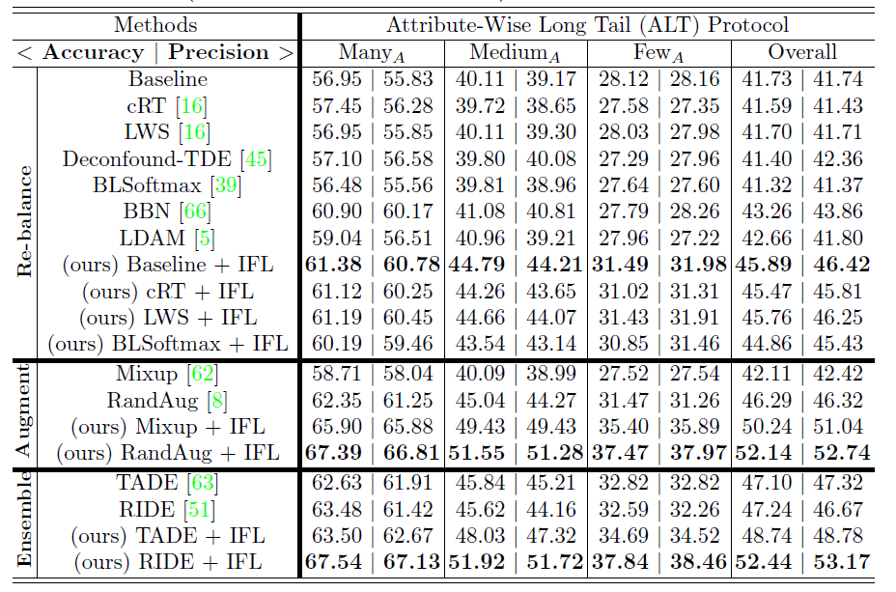
Experiments on ImageNet-GLT
Notes:
This is the results of attribute-wise long tail protocol on imagenet-glt
As we can see, most of the previous re-balancing methods XXX
Here we notice that augmentation and ensemble still work very well in the GLT task
Because, we believe they are actually trying to solve the attribute-wise imbalance problem.
As, Logit Adjustment is theoretically solved the Class-wise LT problem perfectly, the reason why the recent ensemble models like RIDE and TADE still improve the performance is that they are actually providing more robust feature space

Slide 28
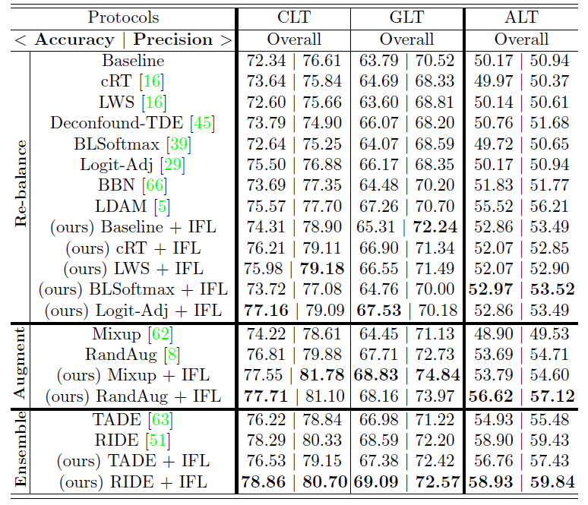
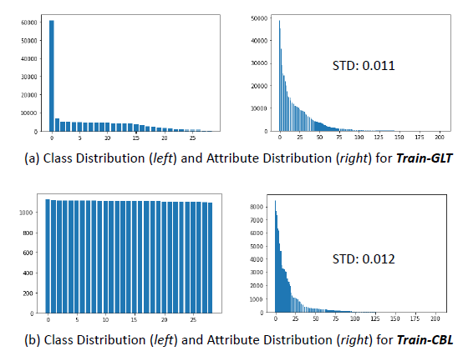
Experiments on MSCOCO-GLT
Q: Why ALT worse than GLT in MSCOCO-GLT?
A large long-tailed dataset is better than a small balanced counterpart (We indeed need to learn from large even biased data!)
Notes:
As to the MSCOCO-GLT, there is a very interesting observation.
GLT is supposed to be harder than pure ALT as it contains two types of biases,
But ALT seems like harder GLT in MSCOCO.
This is because the MSCOCO-GLT benchmark is extremely imbalanced,
The class-wise balanced training set in ALT protocol sacrifices too many head samples.
So the ALT and GLT protocols have different number of training samples in MSCOCO benchmark
This observation proves that XXXX

Slide 29
Why GLT is a “generalized” version of LT
Notes:
The last question is Why the proposed GLT is XXXXXX
If we look at the performances of previous long-tailed algorithms using class-wise re-balancing strategy,
We can find that most of them fail to improve the attribute-wise imbalance in GLT.
On the contrary, the GLT baselines all perform very good in the convention LT protocol.
So the proposed GLT task can better evaluate the robustness of model against the distribution shifts

Slide 30
Conclusions and Suggestions
The pure IID class-wise long-tailed classification is perfectly solved by Logit Adjustment according to $P\left(y | x\right)∝P\left(x | y\right)P(y)$.
Q: How does recent methods like RIDE (improve both head and tail) outperform Logit Adjustment?
A: They just provide a better feature backbone, which is not a LT algorithm.
Q: What are the remaining challenges for LT problems?
1. Multi-modal prediction like VQA, as their LT bias depends on the question.
2. Other new settings: GLT, LT + domain generalization, LT + Incremental Learning, etc.
Notes:
At last, I will give some conclusions and suggestions.

Slide 31
Thank You Q&A

